Slide 1
Tweets & Tone
Vocab in Context
Practice

Slide 2
CONTEXT: Kanye West, in spring of 2018, posted tweets in support of President Trump. John Legend contacted West about this, and West posted their private conversation.
In the tweet, what word best describes
Legend’s tone?
Respectful yet bitter
Affirming yet cautionary
Apathetic yet mournful
Mocking yet hopeful
Answers at end of powerpoint

Slide 3
West’s reply to John Legend.
2. In the tweet, what word best
describes West’s tone?
Angrily sarcastic
Furious yet compliant
Indifferent and detached
Respectfully dismissive
Answers at end of powerpoint

Slide 4
Vocab in context:
3. With so much stark white—the walls, the tiles, the furniture—
the interior decorator decided to pepper the house with pops
of color just to break it up.
In context the word “pepper” most nearly means…
bombard
Vegetable
Accent
Calm
Answers at end of powerpoint

Slide 5
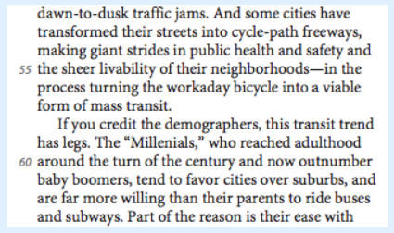
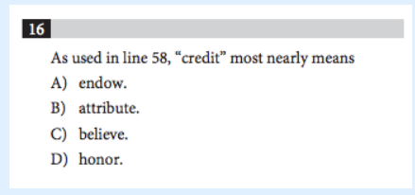
VOCAB in CONTEXT 4.
Answers at end of powerpoint

Slide 6
ANSWERS:
B: Legend acknowledges West’s talent, but warns West that his celebrity status is powerful. Legend wants West to consider how his words/actions can impact others, especially people of color.
D: West makes it clear, in an appropriate, polite way, that he is his own man; West reflects his feeling that Legend is trying to manipulate him, so West pushes back.
C: In this passage the “pops of color” will accent, or give emphasis, in a room that is otherwise all white; the color will break up that monochromatic look.
C. In this sentence “credit” means something like “trust” because the demographers are the ones providing data to suggest that the public transportation is on the upswing. If we trust them, the trend is real.

